Slide 1
Networking Course
Games Academy July 2015
Benjamin Nitschke - Delta Engine

Slide 2
Testing your knowledge
What is the difference between TCP and UDP?
How does TCP handshake works?
What is Network Byte Order?
What is Nagle’s algorithm?
What is TCP_NODELAY?
Which Protocol is used for multicast?
What is TIME_WAIT state?
Write on paper or use //fs2/pub/Networking/<YourName>
Spend max. 5 minutes on this, don’t talk or use google
Notes:
Language does not matter, but doing this in C#, Java, Python, etc. is much easier than trying to do this in native C++, but use whatever you are comfortable with.

Slide 3
TCP vs UDP
TCP is guaranteed delivery, UDP is not guaranteed.
TCP guarantees order of messages, UDP doesn’t.
Data boundary is not preserved in TCP
UDP preserves Data boundary
TCP is much more useful with big data
UDP is much more efficient for small updates
TCP Header size is already 20 bytes (plus frame)
UDP Header size is just 8 bytes (plus frame)
TCP is slower than UDP
Notes:
Size of Ethernet frame - 24 Bytes
Size of IPv4 Header (without any options) - 20 bytes
Size of TCP Header (without any options) - 20 Bytes
So total size of empty TCP datagram - 24 + 20 + 20 = 64 bytes
Size of UDP header - 8 bytes
So total size of empty UDP datagram - 24 + 20 + 8 = 52 byte

Slide 4
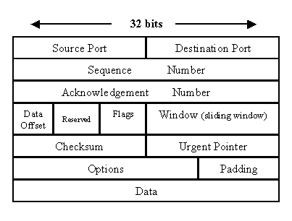
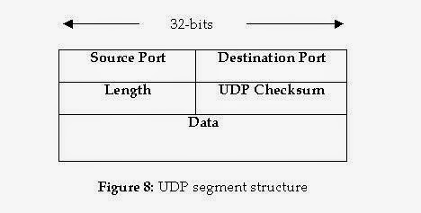
TCP vs UDP
TCP UDP
TC

Slide 5
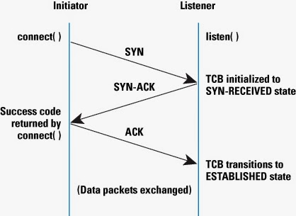
TCP handshake

Slide 6
Network Byte Order
Two ways to store two bytes in memory
little endian (least significant byte at the starting address)
big endian (most significant byte at the starting address)
Intel/AMD uses little endian, storing byte 1, 2, 3, 4
PowerPC uses big endian, storing byte 4, 3, 2, 1
TCP demands big endian byte order, for UDP it is up to you.

Slide 7
Nagle’s algorithm
Improves performance of TCP/IP protocol and networks
Reduces the number of TCP packets that need to be sent
Works by buffering small packets until the buffer reaches Maximum Segment Size
Small packets, which contain only 1 or 2 bytes of data, have more overhead in terms of a TCP header
Small data can also lead to congestion in a slow network
Nagle’s algorithm tries to improve the efficiency of the TCP protocol by buffering them, to send a larger packet

Slide 8
TCP_NODELAY
TCP_NODELAY is an option to disable Nagle’s algorithm

Slide 9
Which Protocol is used for multicast?
Since TCP is a point-to-point protocol, it can not deliver messages to multiple subscriber
UDP is not reliable, and messages may be lost or delivered out of order.
Reliable multicast protocols such as Pragmatic General Multicast (PGM) have been developed to add loss detection and retransmission on top of IP multicast.
Good example of IP multicast is for IPTV applications

Slide 10
TIME_WAIT state in TCP protocol
When one end of a TCP Connection closes it by making system call, it goes into TIME_WAIT state.
Since TCP packets can arrive in the wrong order, the port must not be closed immediately in order to allow late packets to arrive.
That’s why that end of the TCP connection goes into TIME_WAIT state.
If a client closes a socket connection, then it will go to TIME_WAIT state, similarly if server closes connection then you will see TIME_WAIT there
Notes:
You can check the status of your TCP and UDP sockets by using these networking commands

Slide 11
Write a little networking app
Write a TCP/IP Server accepting chat messages and relaying them to any connected client
Write TCP Client sending and reading chat messages
Add UDP support and send out a “ping” chat message from the server every 10 seconds.
Put results to: //as1-ffm/pub$/Networking/<YourName>
Spend max. 30 minutes on this, we abort after and look at the solutions. If you need help at any time, ask, work together, use whatever tools you like (TDD, google)
Notes:
Language does not matter, but doing this in C#, Java, Python, etc. is much easier than trying to do this in native C++, but use whatever you are comfortable with.

Slide 12
Networking APIs
Low level (IP, Raw Data)
Sockets (TCP, UDP)
Http, https, ftp, etc.
Unreal, Unity3D, …
Lidgren, Photon library, WCF, ..
Photon Cloud
Amazon, Google Cloud, Azure (Microsoft)
Notes:
Since we will be coding together now slides do not make so much sense, most things need to be explained and everyone should be typing his game. Links to the existing TextAdventure code will be given in the next slide, which we will only look at by the end of today.

Slide 13
Live Coding
Creation of a Card Game with Networking
As suggested by Kevin ^^
Very simple, just 1 card for each player with one number on it, 1 round, game over
Due to time constraint just in text mode
Then extend or pick another example (e.g. Pong)
Notes:
Since we will be coding together now slides do not make so much sense, most things need to be explained and everyone should be typing his game. Links to the existing TextAdventure code will be given in the next slide, which we will only look at by the end of today.

Slide 14
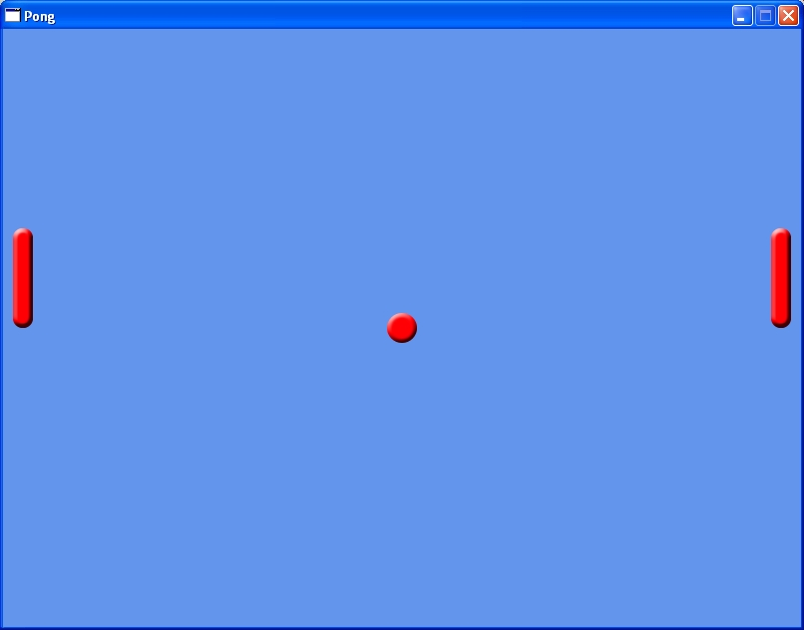
Pong
Write pong with networking for 2 player

Slide 15
Advanced Networking
Locking
Race conditions
Data optimizations
Cloud computing (Azure)

Slide 16
Questions?
All code and these slides are available at:
https://github.com/BenjaminNitschke/NetworkingCourse

Slide 17
Books
Effective TCP/IP Programming
UNIX Network Programming - Volume 1
Algorithms for network programming
C++ Network Programming
TCP/IP Sockets in C: Practical Guide for Programmers
Game Programming Gems 1-8
Clean Code (Robert C. Martin)

Slide 18
C++ & Game Development Links
http://www.hal-pc.org/~johnnie2/winsock.htm
http://tangentsoft.net/wskfaq/
Getting Started with Winsock: https://msdn.microsoft.com/en-us/library/windows/desktop/ms738545(v=vs.85).aspx
http://www.tutorialspoint.com/unix_sockets/
https://github.com/mafiya69/SharpChat

